Slide 1

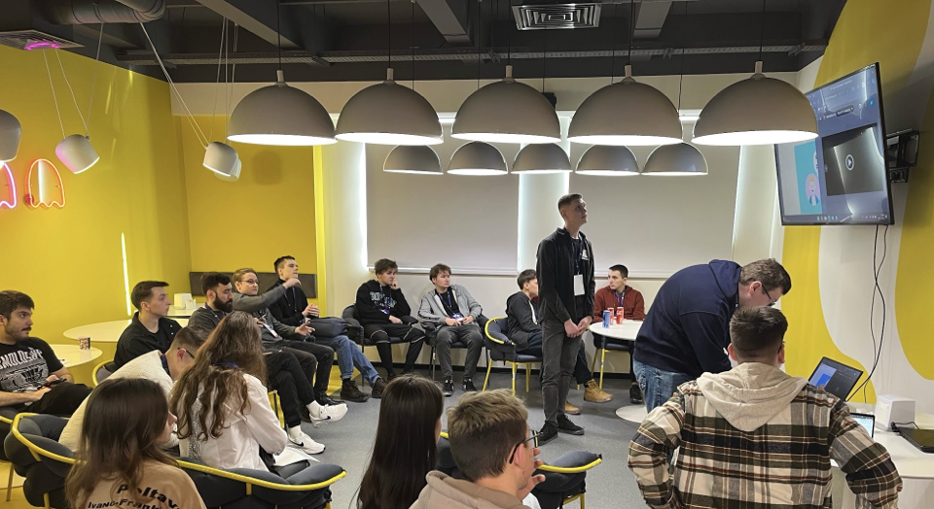

2025

Slide 2

MISSION
To empower all individuals worldwide to learn, experiment, and create together through the medium of games in a safe and welcoming environment.

Slide 3

G4C UNIVERSITY STUDENT CHALLENGE
GGJ has partnered with Games for Change as the jam for 1st G4C University Student Challenge.
To participate through GGJ, use one of three the G4C University Challenge impact theme diversifiers.
Games must be playable in a browser.
Open to participants ages 18-25
  Teams can have “mentor” team members who are over 25.

Slide 4

G4C UNIVERSITY STUDENT CHALLENGE
Continue to develop your game up until April with access to mentors, online resources, feedback and more.
Submit game in April through G4C portal.
Best Game for each of three themes plus Best Game with
  Game of the Year will win a $10,000 Scholarship.

Slide 5
HOW TO PARTICIPATE THROUGH GGJ
Select which one of the three G4C University Challenge diversifiers you want to use.
Tag your game with that diversifier when when uploading your game to the GGJ submission portal.
All team members on the game will receive an email with next steps from GGJ following the jam.

Slide 6
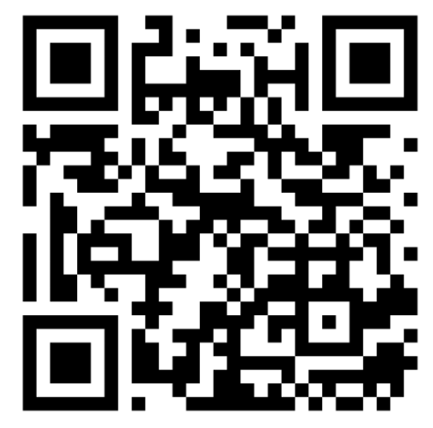
(Not as a GGJ jam game)
HOW TO JOIN AFTER GGJ
For jammers who would like to participate separate from their GGJ jamming: sign up via the QR code.
You will receive an email with next steps following GGJ 2025 (around the first week of February).

Slide 7
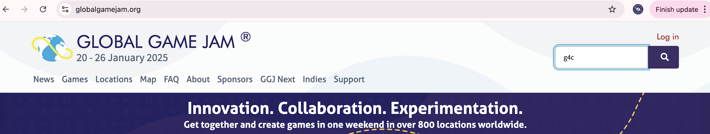
EVERYTHING IS ON GLOBALGAMEJAM.ORG
  Search ”G4C”
  You can also reach out to updates@globalgamejam.org or the G4C channel on GGJ’s Discord.

Slide 8
SHARE YOUR JAM EXPERIENCE ON SOCIAL
We'd love to see you and your jam in the socials! Share your GGJ25 experiences and use the official hashtag #GGJ25 + tag us
@globalgamejam

Slide 9
PLEASE TAKE THE POST-JAM SURVEY!
Please keep an eye out for it at the
end of the weekend.
Your feedback helps us make the jam better!

